Slide 1
IPv4/v6 dual stack for SRAN M-plane
Johan Helenius
11-01-2017

Slide 2
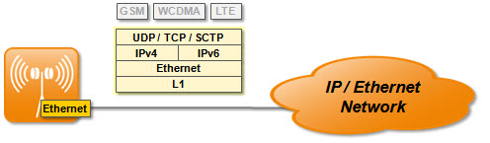
LTE1869:IPv4/IPv6 Transport Stack
LTE1869 (LTE17ASP) points in FP to RP000589, which then contains following
The BTS supports an IPv4/IPv6 dual stack for the external transport interfaces. These can be used for the connections of the U-, C-, M-, and S-plane, and the transport network control plane protocols (such as ICMP or BFD). However, this feature provides only the transport layer foundation for all these functions, the applications (like U-plane, management functions, or BFD) are subject to further features.
IPv4 and IPv6 can be used in parallel (dual stack support), however, the features making use of this generic protocol stack may introduce configuration restrictions.
This feature provides a comprehensive (that is IPv4 and IPv6), flexible (due to dual stack), and generic layer 3 and layer 4 protocol set.

Slide 3
RP000589 Related features
[LTE3433-B-f] Support for already delivered SRAN16.2/16A features - SR000589 LTE664 IPv4/IPv6 Transport Stack
SR001486 Support for already delivered SRAN16.2/16.10 features
SR001137 Legacy SRAN Transport feature porting for AirScale Indoor

Slide 4
RP001186 IPv4/v6 dual stack for SRAN M-plane
Content 1/4
Feature introduces full dual stack IPv4/IPv6 support for SBTS and BTS mediator. SBTS and BTS mediator provides IPv4 and IPv6 M-Plane addresses for services. This covers two addresses for M-Plane.
SBTS provides also dual stack IPv4/IPv6 support for other external interfaces and it enables the dual stack IPv4/IPv6 connection when external device provides it.IPv4/IPv6 dual stack support:
IPv4/IPv6 dual stack is provided for SBTS Element Manager.
BTS Mediator supports IPv4/IPv6 dual stack to SBTS (southbound) and NetAct (Northbound)

Slide 5
RP001186 IPv4/v6 dual stack for SRAN M-plane
Content 2/4
External services e.g. Network Time Protocol (NTP), Operator Lightweight Directory Access Protocol (Operator LDAP), Operator DNS and Certificate Management Protocol (CMP) on IPv4/IPv6 dual stack.
SBTS provides IPv4/v6 dual stack support for BSC M-Plane (OMUsig), but BSC is uses only IPv4 version in the first phase.
IPSec IPv6 is supported.
IPv6 support is provided for Firewall inside SBTS
SBTS is capable of auto-connection and auto-configuration procedures on IPv4/IPv6 dual stack with Transport and with factory SW (bootloader).

Slide 6
RP001186 IPv4/v6 dual stack for SRAN M-plane
Content 3/4
In the SRAN 17A release Plug and Play server is in the BTS Mediator level and this feature enables to use IPv4/v6 dual stack connection to Plug and Play server of BTS Mediator.
DCHPv4/DHCPv6 and Router Solicitation/Advertisement are used to support auto-connection.

Slide 7
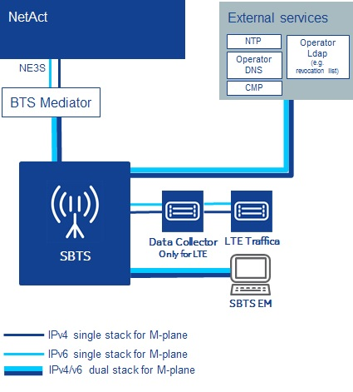
RP001186 IPv4/v6 dual stack for SRAN M-plane
Content 4/4

Slide 8
RP001186 IPv4/v6 dual stack for SRAN M-plane
What does this mean to us?
Need to support both IPv4 or IPv6 towards NA, not both at the same time
Need to support both IPv4 or IPv6 towards BTSs, both at the same time
Currently BTSMED IP addresses defined in NIDD to only IPv4, need definitions for both
Communication matrix needs to be expanded with additional addresses
SW changes to configure IPv4 and IPv6 stacks same time
Rough estimation, Spec 50h, Implementation 200h, integration 150h

Slide 9
How to use this template
1. Set the information classification in the footer.
On the Insert tab, in the Text group, click Header & Footer.
In the Header and Footer dialog box, on the Slide tab, make sure the footer box is ticked.
Change the text in the footer box to the correct information classification from the following:
Public
For internal use
Confidential
Secret
Apply the changes to the information on all of the slides in your presentation, click Apply to All.
2. Set the metadata in slide 7 for Nokia Networks controlled documents – or delete the slide for uncontrolled documents.
A controlled document is one that is written by Nokia Networks, requires formal review and follows an approval process before issue.
See the complete definition of controlled/uncontrolled in section 3.1 of the document control policy here: https://sharenet-ims.inside.nokiasiemensnetworks.com/livelink/livelink/overview/D-1050
Avoid content crossing this line.

Slide 10
Colors and fonts
Use sentence case for slide titles
Core and background colors
Document fonts
Nokia Pure is our business font and should be used as a priority.
If you do not have this font installed, Arial is the acceptable alternative.
the presentation title should be in lower case using Nokia Pure Headline Light.
Slide titles should be in sentence case using Nokia Pure Headline Light.
Body copy text should be sentence case using Nokia Pure Text Light.
R G B
18 65 145
0 201 255
104 113 122
168 187 192
216 217 218
We use blue and white predominantly, and selectively call out key points in light blue. If necessary, we use our palette of grays to help highlight supporting information.

Slide 11
Colors and text combinations
X
!
!
A a
A a
A a
A a
A a
A a
A a
X
Do not use.
Avoid using with small text.
!
A a
X
!
X
!
!
A a
A a
A a
A a
A a
A a
!
!
X
!
A a
A a
A a
A a
A a
A a
A a
A a
X
!
X
X
!
A a
A a
A a
A a
A a
A a
A a
A a
A a
X
X
X
X
A a
A a
A a
A a

Slide 12


Slide 13
Copyright and confidentiality
The contents of this document are proprietary and confidential property of Nokia Solutions and Networks. This document is provided subject to confidentiality obligations of the applicable agreement(s).
This document is intended for use of Nokia Solutions and Networks customers and collaborators only for the purpose for which this document is submitted by Nokia Solutions and Networks. No part of this document may be reproduced or made available to the public or to any third party in any form or means without the prior written permission of Nokia Solutions and Networks. This document is to be used by properly trained professional personnel. Any use of the contents in this document is limited strictly to the use(s) specifically created in the applicable agreement(s) under which the document is submitted. The user of this document may voluntarily provide suggestions, comments or other feedback to Nokia Solutions and Networks in respect of the contents of this document ("Feedback"). Such Feedback may be used in Nokia Solutions and Networks products and related specifications or other documentation. Accordingly, if the user of this document gives Nokia Solutions and Networks feedback on the contents of this document, Nokia Solutions and Networks may freely use, disclose, reproduce, license, distribute and otherwise commercialize the feedback in any Nokia Solutions and Networks product, technology, service, specification or other documentation.
Nokia Solutions and Networks operates a policy of ongoing development. Nokia Solutions and Networks reserves the right to make changes and improvements to any of the products and/or services described in this document or withdraw this document at any time without prior notice.
The contents of this document are provided "as is". Except as required by applicable law, no warranties of any kind, either express or implied, including, but not limited to, the implied warranties of merchantability and fitness for a particular purpose, are made in relation to the accuracy, reliability or contents of this document. NOKIA SOLUTIONS AND NETWORKS SHALL NOT BE RESPONSIBLE IN ANY EVENT FOR ERRORS IN THIS DOCUMENT or for any loss of data or income or any special, incidental, consequential, indirect or direct damages howsoever caused, that might arise from the use of this document or any contents of this document.
This document and the product(s) it describes are protected by copyright according to the applicable laws.
Nokia is a registered trademark of Nokia Corporation. Other product and company names mentioned herein may be trademarks or trade names of their respective owners.
© Nokia Solutions and Networks 2014

Slide 14
Revision history and metadata
Please delete this slide if document is uncontrolled
Document ID: DXXXXXXXXX Document location: Organization:
Version | Description of Changes | Date | Author | Owner | Status | Reviewed by | Reviewed Date | Approver | Approval Date
 |  | DD-MM-YYYY |  |  |  |  | DD-MM-YYYY |  | DD-MM-YYYY

